Slide 1
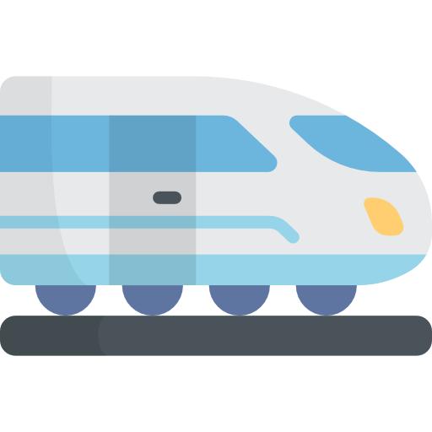
SUMMARY PROPOSAL FOR DESIGN AND DEVELOPMENT of RAIL NETWORK IN THE SOUTH- SOUTH AND SOUTH - EAST NIGERIA.

Slide 2
PROJECT LIFE CYCLE
Closure & handover
Monitoring & Evaluation
Concept Phase
Operational Phase
Pre-feasibility
SESS RAIL PROJECT
Testing and Commissioning
Planning
Construction
design&Engineering

Slide 3

Professor Pat Utomi
Dr Chinonye Okwuosa
Mr Emmanuel Finndoro Obasi
Prof Jude Nzeako
Dr Donald Duke
PROJECT TEAM

Slide 4
PROJECT FACTSHEET
Project Title | South-East & South-South Rail Network
Expected Outcome | Regional Network
Project funding requirement | $15bn
Potential Source (s) of Funding | Private Sector Equity Investor
Expected Commencement date | June 2024
Expected Duration | 18 Months
Contact information | Prof Pat Utomi - Dr Chinonye Okwuosa - Prof Jude Nzeako +447565394466 Mr Emmanuel Finddoro Obasi - Dr Donald Duke - email: info@sessrail.com
Project Ownership

Slide 5
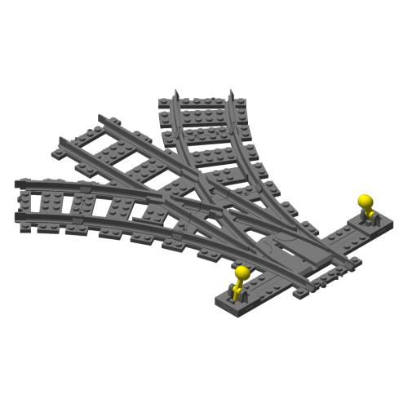
NEED FOR SESS RAIL NETWORK
1. Trade and Commerce:
Both regions are significant hubs for trade and commerce, hosting major markets and business centers. A regional railway network would facilitate the efficient movement of goods between cities, promoting intra-regional trade.
2. Agriculture:
Agriculture is a crucial economic activity in these regions, with fertile land supporting the cultivation of crops and other agricultural products. A railway network can aid in transporting agricultural produce to markets and processing centers, enhancing the agricultural value chain.
3. Oil and Gas Industry:
The South South region is a major player in Nigeria's oil and gas industry, hosting oil-producing states. A railway network would support the transportation of equipment, materials, and personnel, contributing to the growth and efficiency of the industry.

Slide 6

NEED FOR SESS RAIL NETWORK
4. Manufacturing and Industry:
The regions are home to various manufacturing industries, including textiles, pharmaceuticals, and food processing. A regional railway network would provide a cost-effective and reliable means of transporting raw materials and finished goods, supporting industrial growth.
5. Port Operations:
The presence of seaports in cities like Port Harcourt and Warri contributes to maritime trade. A railway network connecting these ports to inland cities would enhance the movement of goods, reducing congestion on roads and optimizing logistics.
6. Commercial Centers:
Cities like Onitsha, Aba, and Enugu are major commercial centers with bustling markets and thriving businesses. A railway network would improve connectivity, making it easier for people to travel for business and trade purposes.

Slide 7
NEED FOR SESS RAIL NETWORK
7. Educational and Healthcare Services:
The regions host renowned educational institutions and healthcare facilities. Improved transportation, facilitated by a railway network, would ease the movement of students, faculty, healthcare professionals, and patients.
8. Tourism:
Both regions boast cultural and natural attractions, including historical sites, festivals, and scenic landscapes. A railway network could boost tourism by making these destinations more accessible, creating economic opportunities in the hospitality and tourism sectors.
9. Urbanization and Real Estate:
A railway network would support the movement of people within and between urban centers, positively influencing real estate development and property values.

Slide 8
NEED FOR REGIONAL SESS RAIL NETWORK
10. MSMEs and Entrepreneurship:
The regions have a vibrant micro, small, and medium-sized enterprise (MSME) sector, with entrepreneurs engaged in various businesses. A railway network would enhance connectivity, enabling MSMEs to reach wider markets and suppliers.
11. Cross-Border Trade:
The proximity of these regions to neighbouring countries like Cameroon and Benin makes them potential hubs for cross-border trade. A regional railway network could facilitate trade links with neighbouring nations.
In conclusion, the South East and South south regions of Nigeria exhibit a dynamic and diverse economic landscape that makes them well-suited for the implementation of a regional railway network. The network would not only support existing economic activities but also stimulate further growth, create employment opportunities, and contribute to the overall development of the regions.

Slide 9

PROJECT CONCEPT
1. Enhance Regional Connectivity:
Establish a comprehensive railway network linking major cities such as Enugu, Port Harcourt, Aba, Owerri, Uyo, Calabar, and others.
Facilitate seamless movement of passengers and goods within and between the two regions.
2. Boost Economic Activities:
Support trade and commerce by providing a reliable and cost-effective means of transporting goods.
Stimulate economic growth by connecting industrial centers, commercial hubs, and agricultural zones.

Slide 10

PROJECT CONCEPT
3.Improve Urban and Rural Accessibility:
Enhance accessibility to urban centers, improving daily commuting for residents.
Extend railway services to connect rural areas, fostering inclusive development and reducing regional disparities.
4.Stimulate Tourism:
Connect cultural and natural tourism destinations to promote tourism within the regions.
Contribute to the growth of the hospitality sector by making tourist destinations easily accessible.

Slide 11
PROJECT CONCEPT
5.Support Industrial and Manufacturing Sectors:
Enable efficient transportation of raw materials and finished goods, supporting the growth of industries.
Facilitate the movement of personnel within the industrial zones, fostering productivity.
6. Promote Environmental Sustainability:
Encourage using eco-friendly technologies, such as electrification, to minimize the project's environmental impact.
Facilitate a modal shift from road to rail, reducing carbon emissions and traffic congestion.

Slide 12
PROJECT CONCEPT
7. Enhance Educational and Healthcare Connectivity:
Improve transportation for students, faculty, and healthcare professionals between cities with educational and healthcare institutions.
Enhance access to quality education and healthcare services for residents across the regions.
8. Create Employment Opportunities:
Generate employment opportunities during the construction phase.
Stimulate job creation indirectly through increased economic activities associated with the operational phase.
9. Promote Regional Integration:
Foster closer economic ties between the South East and South-South regions.
Contribute to national economic development by enhancing connectivity between different regions.

Slide 13
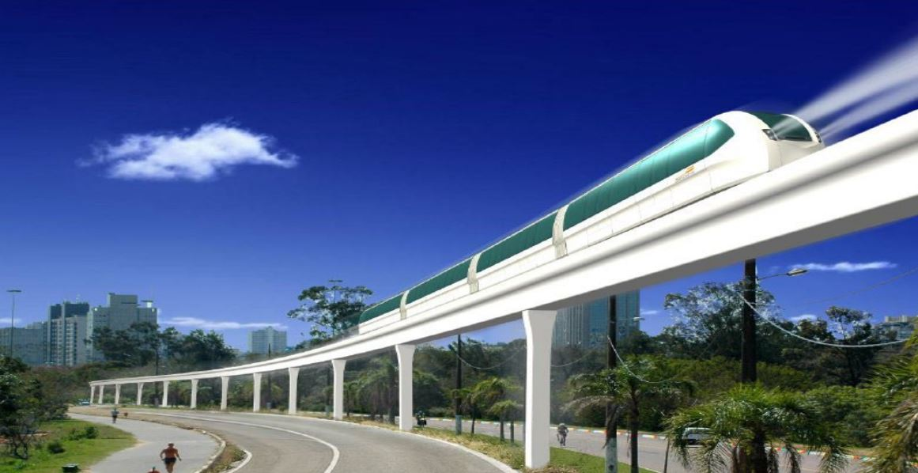
OBJECTIVES
Objectives:
Identify the need for improved
regional transportation.
Establish a core project team.
Conduct a preliminary feasibility study.
Key Activities:
Formulate the project concept.
Assemble a multidisciplinary project team.
Conduct initial stakeholder consultations.
Secure initial funding for the feasibility study.
Deliverables: Project initiation document.
Preliminary feasibility report.

Slide 14
THE PROJECT PHASES
Concept Studies
Prelim Feasibility
Studies
Infrastructure
Development
PHASE 1
PHASE 2
PHASE 3
Feasibility Studies
and
Route Mapping

Slide 15
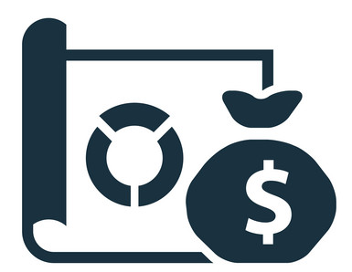
Concept Studies $
Project Definition and Route Mapping = $
Project Infrastructure Development and Logistics = $15bn
PROJECT FUNDING

Slide 16
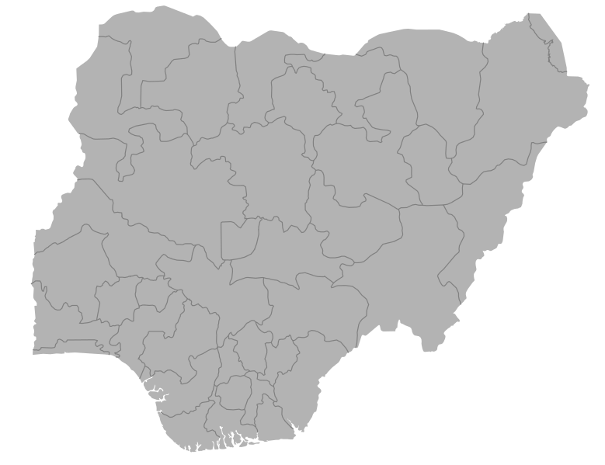
BACKGROUND
The South East And South-South Nigeria are in strategic locations in the Country.
The combined regions population is estimated to be 65M.
Nigeria imports over 131 million tons of cargo each year .
It is estimated that the transregional corridor through this rail project has the potential to transport 50 million–100 million tons of cargo each year.

Slide 17
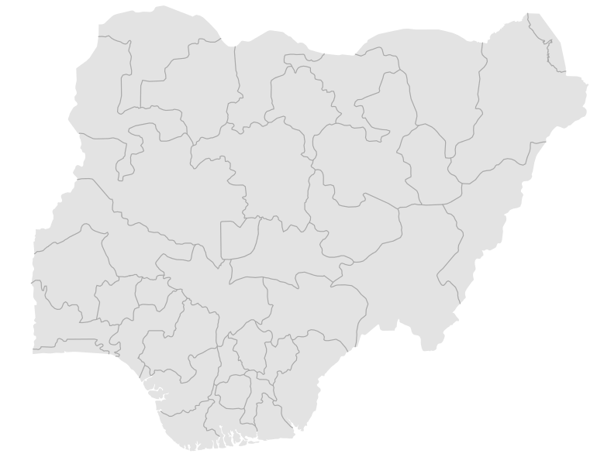

ECONOMIC CORRIDORS
Nigeria has two major local economic corridors:
The Western Economic Corridor (LAKAJI) and
the Eastern Economic Corridor (2NEC).
The LAKAJI corridor runs from Lagos, Kano, and Jibiya in Katsina State.
The Eastern corridor, goes from Port Harcourt, through Enugu, to Maiduguri, has been abandoned.
This project will likely reactivate it.

Slide 18
EXISTING CONDITIONS
Key findings:
Railways in Nigeria consist of a 3,505 km Cape gauge national railway network and
669 km of standard gauge.
The Cape gauge network is in poor condition due to lack of maintenance.
Nigeria’s rail lines are divided into two.
The Western Line and the Eastern Line.
The western line connects of Lagos on the Bight of Benin to Naguru in the northern state of Yobe, over a distance of 1,126 kilometres,
The eastern Line connects Port Harcourt in the southeast to Maiduguri in the northeastern state of Borno, near the border with Chad (currently not fully functional)
There is no active rail corridor in the two S regions.

Slide 19

PROBLEM ANALYSIS
Economic Challenges:
High levels of youth and graduate unemployment
Poor road and transport infrastructure affecting economic activities
Transportation and Agricultural Issues:
Limited access to farms and markets for the movement of farm produce
Inefficient transportation network hindering regional growth

Slide 20

RAIL CORRIDORS IN NIGERIA
157 km
Lagos-Ibadan standard gauge rail.
186 km
Abuja-Kaduna standard gauge rail line
327 km
Itakpe-Warri standard gauge rail
Agbor Railway Village
Abuja Light Rail project
284 km
Kano-Maradi Standard Gauge Rail

Slide 21




GOALS
Alleviate unemployment by creating jobs through the construction and operation of the regional rail system.
Enhance economic activities and trade within and between states in the region
Improve access to farms, markets, and other essential services.

Slide 22
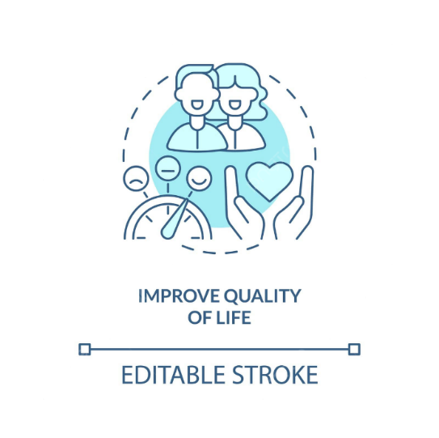


THE IMPORTANCE OF THE REGIONAL RAIL NETWORK
Regional rail is about more than commuting to and from the city during weekday rush hours. Work, shopping, games, concerts, and other events can all be served by regional rail. These trips can be from suburb to city, suburb to suburb, city to city, or within the city.
Elevated above regular traffic and aligned to existing roadways for right-of-way.
Fully Net-Zero Carbon Neutral.
Accommodates 278 passengers in seated and standing format and 292 in crush-format.
Designed for short operating headways between stations of approximately 750 meters to 1.5 kilometers on average.
Uses only 19 watts of energy per passenger kilometer.
Maximum operation speed 120 km/hour.
Zero impact on day-to-day traffic flow in rapidly urbanizing cities.
Provides high station-to-station speeds and is quick & efficient in respect of point-to-point commuter transit times.
Boost the economy
Improve lives
Protect the environment

Slide 23
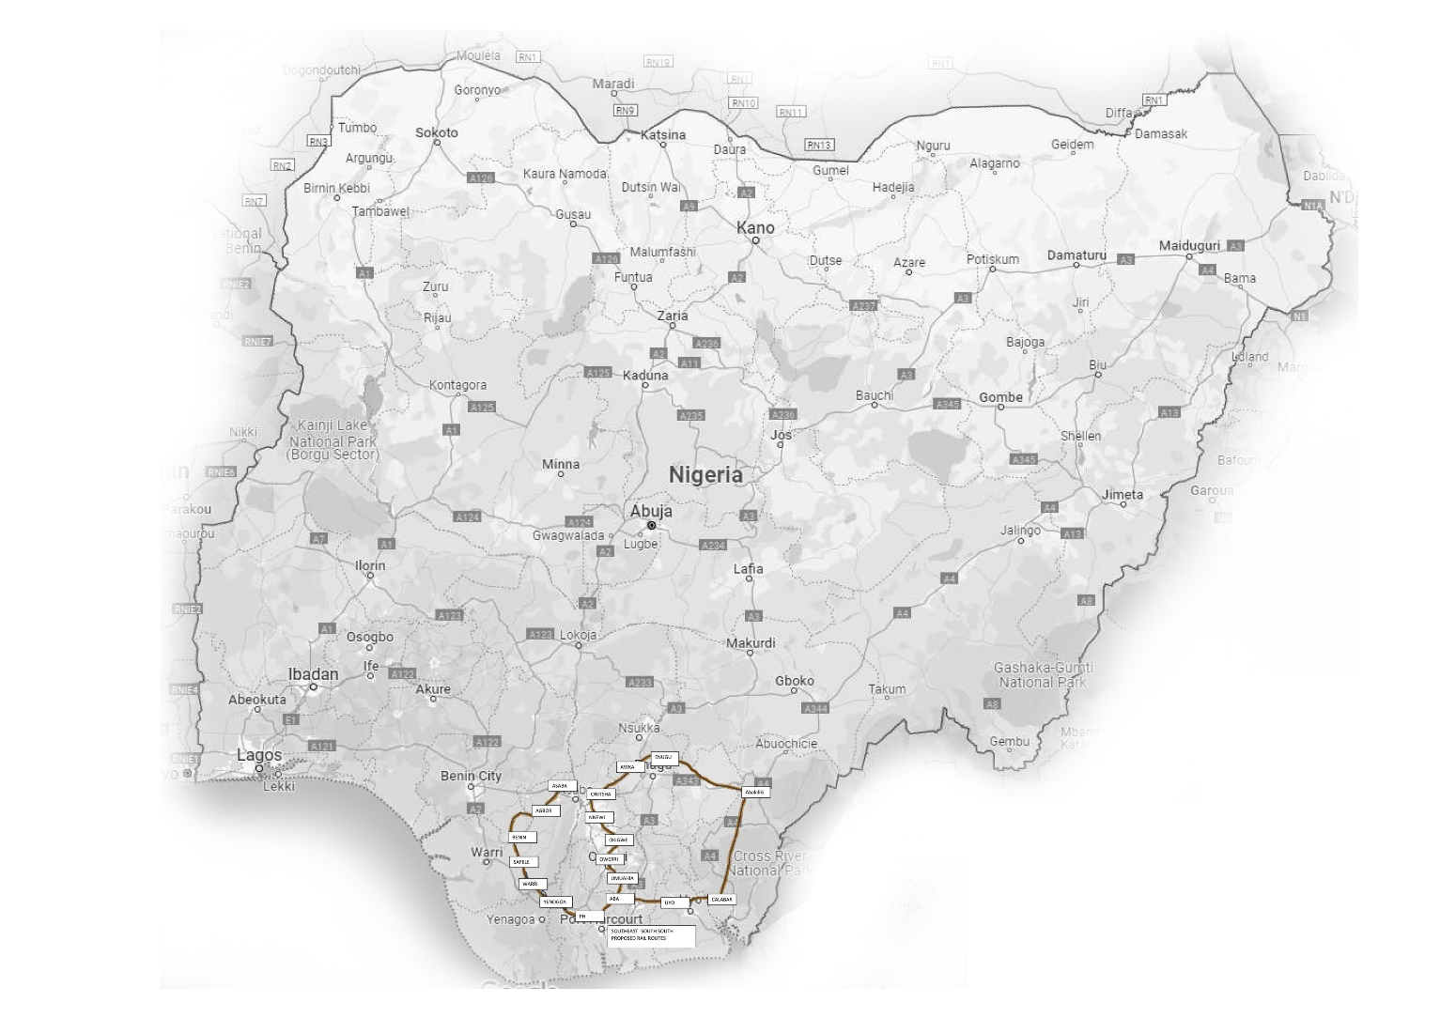
PROJECT OVERVIEW
This project aims to provide detailed geographical and topographical information for the proposed railway lines connecting key cities in the South-South and South-East regions of Nigeria. The survey will map the right-of-way (R-of-W) for each proposed route, including stations, for land acquisition purposes.
Route No. | Origin City | Destination City | Estimated Distance (km)
1 | Abakaliki | Enugu | 100
2 | Enugu | Awka | 75
3 | Awka | Onitsha | 35
4 | Onitsha | Nnewi | 46
5 | Nnewi | Okigwe | 66
6 | Okigwe | Owerri | 61
7 | Owerri | Umuahia | 59.6
8 | Umuahia | Aba | 54
9 | Aba | Uyo | 68
10 | Uyo | Calabar | 94
11 | Calabar | Abakiliki | 187
12 | Aba | Port Harcourt | 63
13 | Port Harcourt | Yenagoa | 140
14 | Yenagoa | Warri | 155
15 | Warri | Benin City | 111.7
16 | Benin City | Asaba | 132.7
75km
100km
70km
35km
62.7km
46km
62.7km
66km
61km
187km
49km
59.6km
54km
155km
63km
140km
68km
87.5km

Slide 24
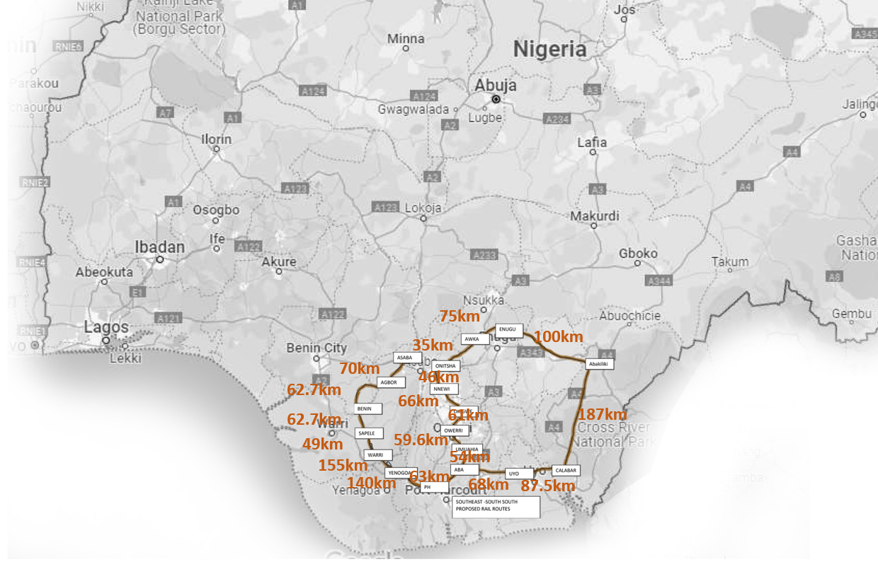
PROPOSED ROUTES MAP

Slide 25
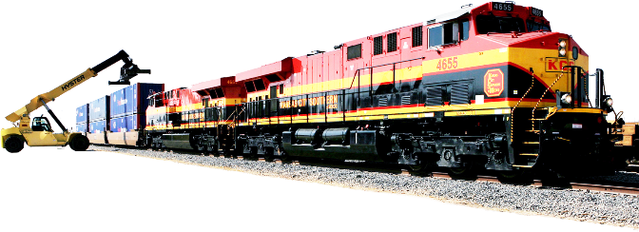
ECONOMIC BASES AND RESOURCES
Potential Economic Base:
Transportation and logistics
Tourism and leisure
Capital
Land and natural resources
Agriculture and manufacturing
Required Resources:
Expertise and technology
Labor
Low capital costs coupled with low operating costs
Low ticket pricing

Slide 26





RISK AND VULNERABILITY ASSESSMENTS
Environmental Risks: Erosion, deforestation, habitat disruption, flooding, waste disposal.
Social Risks: Land acquisition conflicts, resettlement challenges, safety concerns, cultural impact.
Economic Risks: Project cost overruns, funding delays, market changes, competition from other transport modes.
Security Risks: Vandalism, theft, accidents, terrorist attacks.
Mitigation Strategies: Environmental studies, stakeholder engagement, land acquisition plans, safety measures, security protocols, insurance coverage.

Slide 27
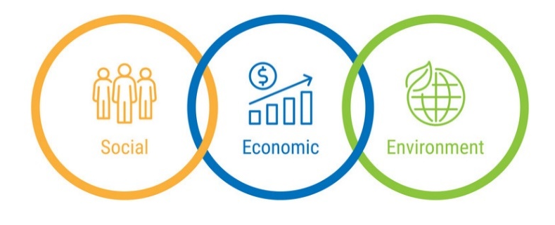
ECONOMIC, SOCIAL AND ENVIRONMENT BENEFITS
Economic:
Relative to other mass transport modalities.
Offers low capital costs coupled with low operating costs, which translates into low ticket pricing.
Ideal for poorer communities, who need quality, low-cost, reliable public transport.
Social:
Improved access to education, healthcare, and markets, poverty reduction, enhanced quality of life.
High-speed inter-city freight & passenger systems.
Environmental:
Zero impact on the environment – no noise, no pollution and no congestion and is thus an excellent metropolitan citizen and neighbor, especially in congested urban settings.
The very compact installation footprint minimizes the need for land expropriation / compensation as rights-of-way are typically owned / controlled by the contracting governmental authority.

Slide 28

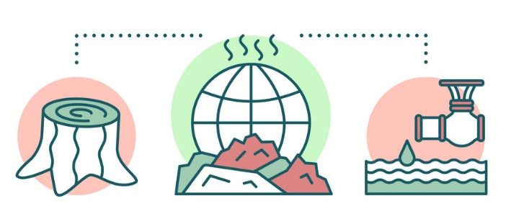
ENVIRONMENTAL AND SOCIAL IMPACT
The proposed railway lines in South-South/South-East Nigeria have the potential to be a transformative force for regional development. However, it's crucial to consider the potential environmental and social impacts of such a project to ensure its sustainability and positive impact on local communities.
Environmental Impacts:
Social Impacts:
Habitat loss and fragmentation
Deforestation and soil erosion
Water pollution
Air pollution
Noise pollution
Land acquisition and resettlement
Cultural impacts
Safety concerns
Economic benefits and livelihood opportunities

Slide 29
INFRASTRUCTURE
Objective
The primary objective of constructing a rail line infrastructure linking the South East and South-South States of Nigeria is to:
Enhance regional connectivity,
Foster economic development,
Promote social integration.
This ambitious project aims to address various challenges and capitalize on opportunities, with the overarching goal of contributing to the sustainable growth of the regions involved

Slide 30



INFRASTRUCTURE CONT’D
Specific Objectives
Improved Transportation Efficiency: Develop a modern and efficient rail network to facilitate the seamless movement of goods and passengers between the South East and South-South States. This will alleviate congestion on existing road networks, reduce transportation costs, and enhance overall logistical efficiency.
Economic Development: Foster economic growth by creating new opportunities for trade, commerce, and investment. The rail infrastructure will provide a reliable and cost-effective means of transporting goods, stimulating business activities, and attracting both local and foreign investments to the regions.

Slide 31


INFRASTRUCTURE CONT’D
Specific Objectives
Job Creation: Generate employment opportunities through the various stages of the rail line's construction, maintenance, and operation. Additionally, the improved connectivity is expected to spur economic activities, leading to the creation of jobs in industries related to transportation, trade, and services.
Enhanced Regional Integration: Strengthen social ties and cultural exchange between the South East and South-South States, promoting a sense of unity and collaboration. The rail line will serve as a catalyst for regional integration, fostering mutual understanding and encouraging shared development goals.

Slide 32

INFRASTRUCTURE CONT’D
Specific Objective:
Environmental Sustainability: Encourage the use of environmentally friendly transportation by shifting a significant portion of freight and passenger traffic from road to rail. This transition aims to reduce carbon emissions, minimize environmental impact, and contribute to a more sustainable mode of transportation.

Slide 33
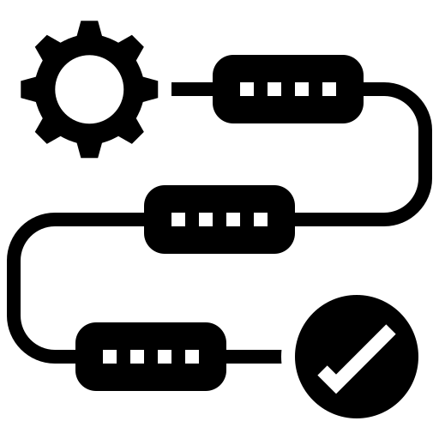
METHODOLOGY
Phase I - Establishment of Rail Authority
Phase II -Rail Infrastructure Development
Phase III -Build and Manage Rail Operations
Phase IV -Launch Rail Services
Phase V -Rail Relationship Management
Phase VI -Capacity Building, Knowledge sharing etc

Slide 34

JUSTIFICATION FOR PROJECT
The proposed railway network holds significant potential for socio-economic development in South-South/South-East Nigeria.
Sustainable development possible because of fully net zero carbon neutral and no fossil fuels used.
Zero impact on day-to-day traffic flow in rapidly urbanizing cities.
More passenger can use it for their daily transportation.
More time efficient.

Slide 35

Project Development Process for the South East and South-South Regional Rail Network in Nigeria:
1.Prelim Feasibility Study:
a. Market Analysis:
Demand for regional rail services, considering population density, urbanization trends, and economic activities in each state.
South East South South Population Density 2024
Abia | 863
Anambra | 1263.9
Akwa Ibom | 721.1
Bayelsa | 270.2
Cross River | 209.6
Delta | 331.8
Ebonyi | 499.8
Edo | 244.2
Enugu | 615
Imo | 1063.2
Rivers | 773.3

Slide 36
URBANISATION TRENDS 2012 TO 2022
2012 | 45.20%
2013 | 46.12%
2014 | 46.98%
2015 | 47.84%
2016 | 48.68%
2017 | 49.52%
2018 | 50.34%
2019 | 51.16%
2020 | 51.96%
2021 | 52.75%
2022 | 53.52%
Source: Statista 2024

Slide 37

NIGERIA’S URBAN POPULATION’S GROWTH:
Robust economic growth over the past decade accelerated URBANIZATION
According to UN figures just under 50% of Nigeria’s population now live in urban areas and this proportion is projected to reach 67% by 2050 (United Nations, 2014).

Slide 38

Key economic activities in these regions:
Trade and Commerce:
A regional railway network would facilitate the efficient movement of goods between cities, promoting intra-regional trade.
Agriculture:
A railway network can aid in transporting agricultural produce to markets and processing centers, enhancing the agricultural value chain.
Oil and Gas Industry:
A railway network would support the transportation of equipment, materials, and personnel, contributing to the growth and efficiency of the industry.

Slide 39

Manufacturing and Industry:
The regions are home to various manufacturing industries, including textiles, pharmaceuticals, and food processing.
Port Operations:
Seaports in Port Harcourt, Calabar, Onne, and Warri fuel maritime trade; a railway network linking them to inland cities would ease goods transport, reducing road congestion and optimizing logistics.
Commercial Centers:
A railway network would improve connectivity, making it easier for people to travel for business and trade purposes.
Educational and Healthcare Services:
The regions host renowned educational institutions and healthcare facilities. Improved transportation, facilitated by a railway network, would ease the movement of students, faculty, healthcare professionals, and patients.

Slide 40
Key Economic Activities
Tourism:
A railway network could boost tourism by making these destinations more accessible, creating economic opportunities in the hospitality and tourism sectors.
Urbanization and Real Estate:
Urbanization increasing in Port Harcourt, Enugu, and Uyo; railway network would improve mobility, boost real estate, and raise property values.
MSMEs and Entrepreneurship:
Regions boast vibrant MSME sectors; railway network could expand market access, connecting entrepreneurs to wider markets and suppliers, fostering growth.
Cross-Border Trade: Proximity to Cameroon and Benin positions regions as cross-border trade hubs; a regional railway network could strengthen trade ties with neighboring nations.

Slide 41

POTENTIAL PASSENGER TRAFFIC
Urban Commuting:
Growing urban centers in South East and South South regions need improved transportation; a regional rail network could alleviate congestion and offer efficient intra-city mobility.
Inter-State Travel:
Major cities in South East and South South serve as hubs. A regional rail network could offer fast, reliable inter-city travel options.
Tourism:
Regional rail network in South East and South South regions can enhance tourism by improving access to cultural and natural attractions, increasing passenger traffic for leisure activities.

Slide 42
2. Potential Freight Traffic:
Manufacturing and Industry:
Regional rail network in South East and South South regions would streamline transportation of raw materials and finished goods, lowering costs for businesses.
Agricultural Products:
A rail network in these regions would enhance transportation of agricultural products, bolstering regional and national food supply chains.
Oil and Gas Sector:
The South-South region is a key hub for the oil and gas industry; a rail network would efficiently transport equipment, materials, and products linked to this sector.
Inter-Regional Trade
Better rail freight connections could boost inter-regional trade by efficiently transporting goods between the South East, South South regions, and beyond.

Slide 43

3. ANALYSIS OF EXISTING TRANSPORTATION INFRASTRUCTURE:
Road Network:
The region's road network links major cities but faces challenges like congestion, maintenance issues, and the need for expansion to support population growth and economic activities.
According to Industry operators, only 37% of Nigeria’s 195,000 kilometres of roads are currently in good condition, with the remaining 63% in disrepair.
Rail Network: Existing rail network in region limited; cities like Enugu, Port Harcourt, Aba have connections, but expansion and modernization needed for broader connectivity as many states lack rail access.
According to National Bureau of Statistics (NBS), rail infrastructure accounted for less than 1% of the transportation sector’s contribution to Nigeria’s (GDP) at the end of 2021.

Slide 44


3. ANALYSIS
Airports:
Region has airports, including Port Harcourt, Enugu, and Owerri; air travel not affordable for most. A regional rail network could offer an alternative, complementing existing options. Air transportation growing due to security concerns on highways, but industry's contribution to GDP remains low due to terminal facilities' lack of expansion.
Water Transportation:
Nigeria’s waterways span 10,000 kilometers, although only circa 3,800 kilometers are navigable. 28 of the 36 states in Nigeria can be accessed through the waterways. The Niger and Benue rivers constitute the major channels for inland navigation which include but are not limited to the Cross River, Port Novo- Badagry-Lagos waterways, as well as the Lekki and Lagos lagoons.

Slide 45

FEDERAL NAVIGABLE WATERWAYS
1. The River Niger from the Nigerian/Niger/Benin border, through the Nun and Forcados distributaries to the Atlantic Ocean.
2. The River Benue from the Nigerian/Cameroun border to its confluence with River Niger at Lokoja.
3. The Cross River from the Nigerian/Cameroun border to the Atlantic. Ocean, and all its distributaries.
4. Rivers Sokoto. Kaduna. Geriny. Gongola. Taraba. Donga. Katsina-Ala. Anambra. Ogun. Oluwa. Osse, Benin, Imo. Kwa Ibo.

Slide 46
FEDERAL NAVIGABLE WATERWAYS
5. The Intra-coastal route from Badagry. along the Badagry Creek to Lagos through Lagos Lagoon to Epe, Lekki Lagoon lo Iwopin and other channels.
6. The waterway from Warri along the Forcados River, through Frukana, Siama. Bomadi. Angalabiri. Patani, Torofani. down River Nun to Agberi, Kiama and others.
7. The waterway from Port Harcourt, through Amadi Creek down Bonny River, into Opobo Channel Adoni River, through Andoni Flats, Tellifer Creek, Imo River. Shooter Creek. Kwa Ibo Creek, Kwa Ibo River, Stubbs Creeks. Widenham Creek, Effiat-Mbo Creek, Cross River estuary to Oron and Calabar.

Slide 47
FEDERAL NAVIGABLE WATERWAYS
8. Rivers Benin. Ethiope, Ossiomo. Onne, Aba. Azumini, Olomum. Siluko, Talifa, Forcados, Penington, Escravos, Warri, Ramos and through other rivers.
9. Creeks Odiama, Agamama Tora, Nembe, Krakama, Buguma, Bille, Finima, New Calabar, Ekole, Cawthprne Channel, Ikane-Bakassi, Omu, Kwato (Gwato), Adagbrassa and others.
10. Lakes Mahin, Oguta, Osiam Ehomu.
11. The Orashi River from Oguta Lake to Ebocha, Omoku, Kreigani, Moiama., Okariki, Egbema, Sombreiro River.
12. Lake Chad, that part within Nigeria.

Slide 48

URBAN TRANSPORTATION:
Urban centers in the regions encounter traffic congestion and insufficient public transportation infrastructure; investing in urban transportation systems would complement regional rail connectivity.
The South East and South South regions of Nigeria have substantial potential for passenger and freight traffic, necessitating the development of a modern, integrated regional rail network to address current challenges and drive economic growth and regional development.

Slide 49
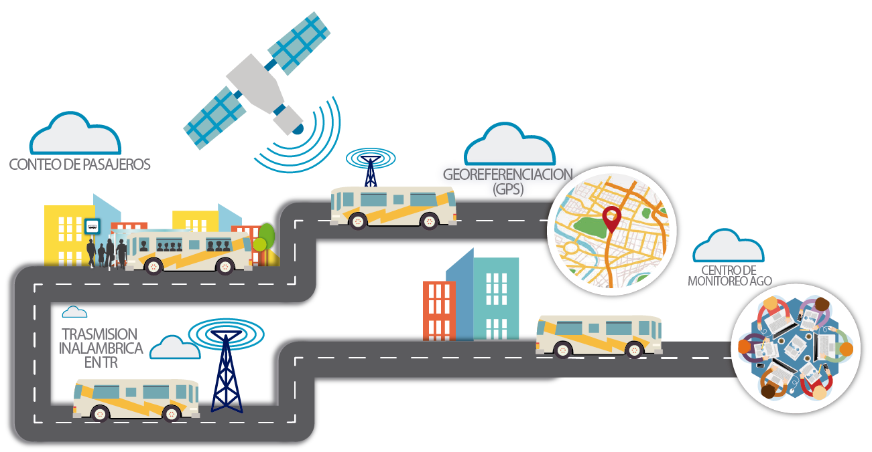
COMPETITOR SERVICES AND ALTERNATIVE TRANSPORTATION OPTIONS. TRAVEL COST:
Abakiliki to Port Harcourt
Road
Flight
Waterway
Rail
Benin to Akwo Ibom
Road
Flight
Waterway
Rail

Slide 50
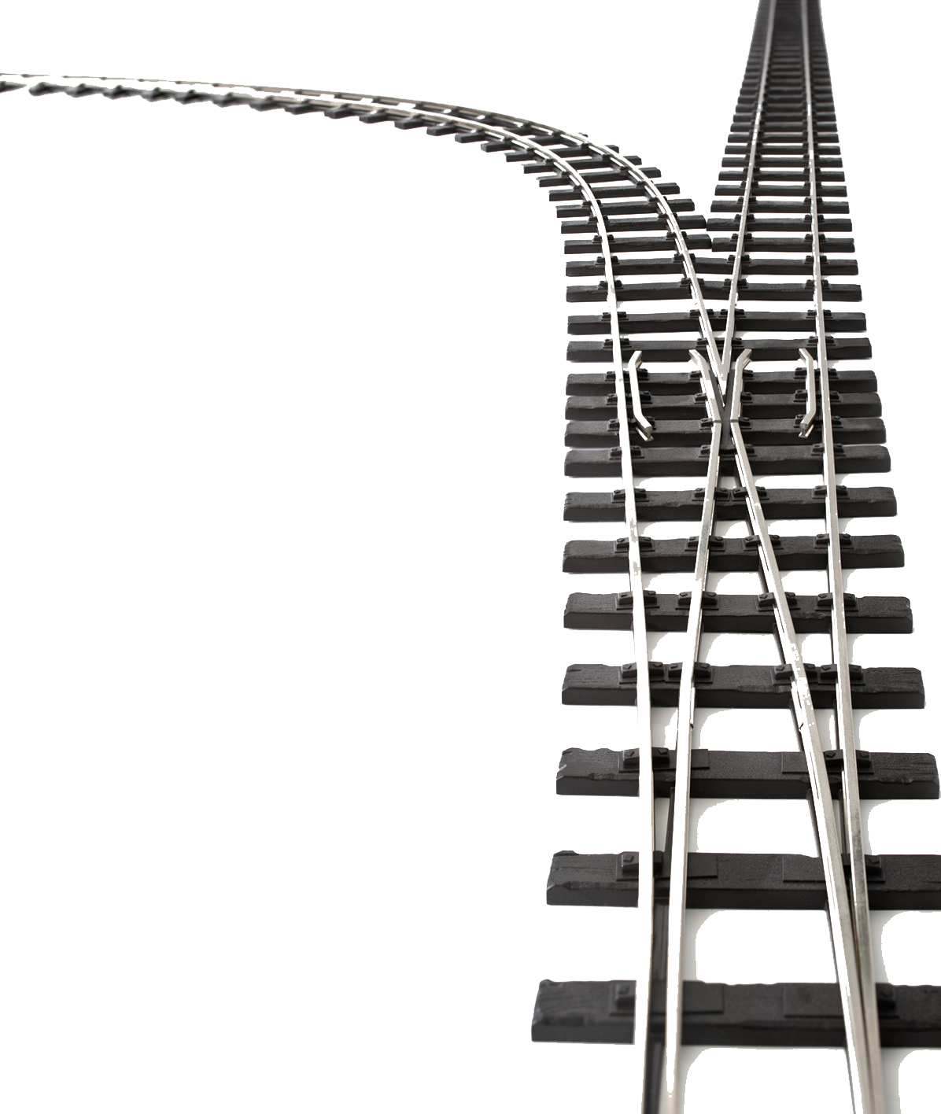
TECHNICAL ANALYSIS:
Nigeria's railway network serves only a small portion of the country. The country is 923,770 km², with a railway network of 3,505km colonial narrow gauge and 669 km modern standard gauge. The SESS region has less than 5% of this.
Existing Rail Lines:
Eastern Line:
The Eastern Line, which passes through the South East region, connects major cities like Port Harcourt, Enugu, and Aba.
Key segments of the Eastern Line include Port Harcourt to Aba and Aba to Enugu. This line has the potential to serve as a foundation for further expansion.
Coastal Line:
The Coastal Line passes through the South South region, connecting cities such as Port Harcourt.
This line has the potential to facilitate the transportation of goods and passengers along the coastal areas of the South South.

Slide 51

POTENTIAL INTEGRATION POINTS:
Port Harcourt:
Port Harcourt serves as a major economic hub in the South South. Integrating existing rail lines with the port's infrastructure could enhance transportation of goods, especially in the oil and gas sector.
Enugu:
Enugu is a key city in the South East, and integrating the rail network with the existing infrastructure could improve connectivity, serving both passengers and freight.
Aba:
Aba is an industrial and commercial center in the South East. Enhancing rail connectivity in Aba could support the movement of goods produced in the region.
Onitsha:
Onitsha is a major commercial city, and integrating the new rail network with the existing transportation hubs could enhance connectivity for both passengers and freight.

Slide 52

REQUIRED UPGRADES AND EXPANSIONS:
Modernization of Rail Infrastructure:
Upgrading the existing rail lines to modern standards, including the use of high-speed rail technology, can improve efficiency and reduce travel times.
Extension of Rail Lines:
The proposed regional rail network will expand the existing rail lines to connect more cities and towns within the South East and South South regions and can enhance regional connectivity.
Double-Tracking and Electrification:
Double-tracking existing rail lines and electrification can increase capacity and efficiency, supporting the transportation of both passengers and freight.
Integration with Other Modes of Transport:
Integrating rail infrastructure with other modes of transportation, such as road and air, can create a seamless and inclusive comprehensive transportation network.
Upgrade of Rail Stations:
Upgrading rail stations to modern standards can improve passenger experience and provide necessary facilities for freight handling.

Slide 53
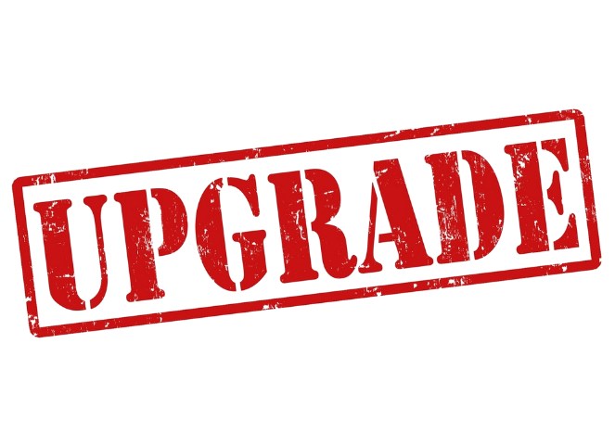
Required Upgrades and Expansions:
Investment in Maintenance and Safety:
Regular maintenance of rail tracks, bridges, and other infrastructure is crucial for safety and reliability. Investing in maintenance facilities and safety measures is essential.
Community Engagement and Land Acquisition:
Community engagement is vital for successful rail projects. Clear communication, addressing community concerns, and fair land acquisition processes are important aspects of successful integration.
Technological Integration:
Incorporating modern technologies for ticketing, scheduling, and cargo tracking can enhance the overall efficiency of the rail network.
Environmental Considerations:
Considering environmental factors and implementing eco-friendly practices in rail construction and operation is essential for sustainable development.
Collaboration with Private Sector:
Public-private partnerships can play a significant role in funding and executing rail infrastructure projects. Collaborating with the private sector can bring in expertise and investment.

Slide 54
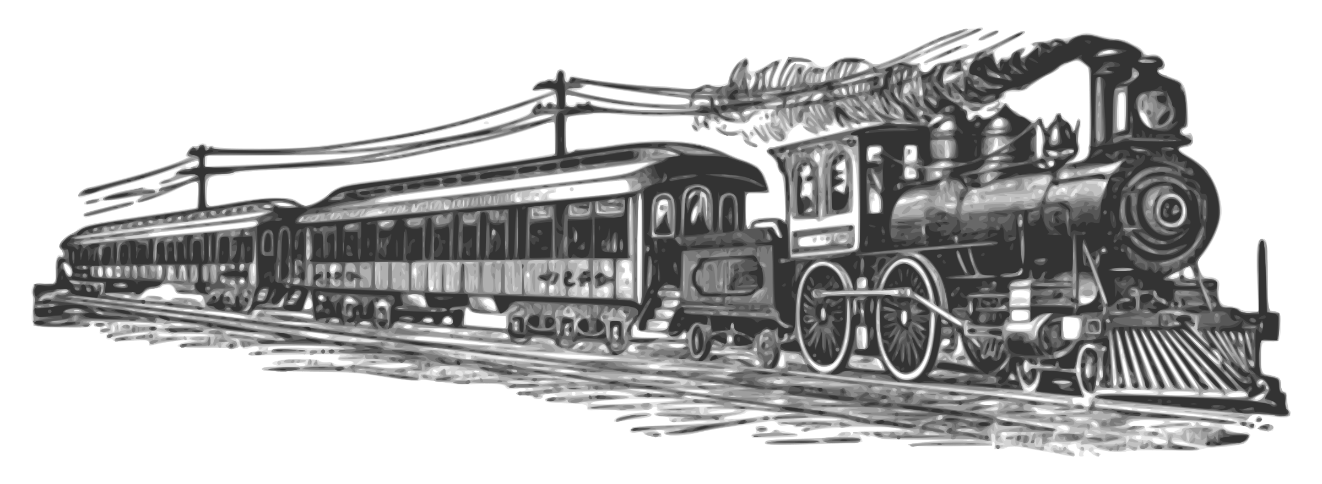
FEASIBILITY OF IMPLEMENTING THE REGIONAL RAIL NETWORK
Topography: The terrain in the South East and South South regions varies from flat coastal plains to undulating and hilly landscapes. Identifying and addressing topographical challenges is crucial for laying tracks and ensuring safe and efficient train operations.
River Crossings: The presence of rivers, such as the Niger and its tributaries, may necessitate the construction of bridges or tunnels. Proper engineering solutions must be employed to accommodate river crossings while minimizing environmental impact.
Soil Conditions: Conducting soil surveys is essential to understand soil conditions for track foundation. In areas with challenging soil types, appropriate engineering solutions like soil stabilization may be required.

Slide 55
FEASIBILITY OF IMPLEMENTING THE REGIONAL RAIL NETWORK
Tunnels and Bridges: Where the terrain is challenging, such as in hilly or mountainous areas, the construction of tunnels and bridges may be necessary. Engineering assessments should consider factors like soil stability, seismic activity, and water flow.
Environmental Impact:
Ecological Sensitivity: The regions are ecologically diverse, with unique flora and fauna. Conducting environmental impact assessments (EIAs) is critical to identify potential impacts on ecosystems and wildlife. Mitigation measures must be implemented to minimize harm.
Wetlands and Water Bodies: Rail projects may intersect with wetlands and water bodies. Special care is needed to avoid disrupting these ecosystems, and measures like elevated tracks or wildlife corridors may be considered.

Slide 56
FEASIBILITY OF IMPLEMENTING THE REGIONAL RAIL NETWORK
Noise and Vibration: The construction and operation of rail networks can generate noise and vibrations that may affect nearby communities. Mitigation measures, such as noise barriers and track isolation, must be implemented to minimize disturbances.
Cultural Heritage: The regions have rich cultural heritage sites. Engineering plans should consider avoiding or minimizing impacts on historical and cultural landmarks.
Land Use Planning: Collaborating with local authorities for land use planning is crucial to prevent conflicts with existing land uses and ensure that the rail network complements regional development goals. Governors and Ministries of Lands of the regions need to assist.

Slide 57

FINANCIAL ANALYSIS:
Potential revenue streams, considering ticket sales, freight services, and potential partnerships.
Assessing potential revenue streams for a regional rail network involves considering various sources of income. Here's an overview of the potential revenue streams for a regional rail network, taking into account ticket sales, freight services, and potential partnerships:

Slide 58

FINANCIAL ANALYSIS CONT’D
Passenger Tickets:
Revenue from selling tickets to passengers for travel within the regional rail network.
Different fare classes (e.g., standard, business, first-class) can offer varied pricing options.
Discounts for frequent travelers, students, seniors, or special events can attract a diverse customer base.
Season Tickets and Subscriptions:
Offering season tickets for regular commuters or subscription-based models for unlimited travel within a specific period.
This provides a predictable revenue stream and encourages loyalty among frequent travelers.
Special Packages and Promotions:
Introducing special packages, family discounts, or promotional offers to boost ticket sales during off-peak periods or special occasions.

Slide 59

FINANCIAL ANALYSIS CONT’D
Cargo and Freight Transportation:
Generating revenue by transporting goods and cargo between cities and industrial hubs.
Offering specialized freight services for industries requiring rapid and secure transportation.
Logistics Partnerships:
Collaborating with logistics companies for last-mile delivery services, further expanding the rail network's reach and revenue potential.
Express Freight Services:
Providing expedited freight services for time-sensitive deliveries, potentially at premium rates.
Public-Private Partnerships (PPP):
Partnering with private entities for infrastructure development, operation, and maintenance in exchange for revenue-sharing agreements.
Attracting private investors for funding capital-intensive projects.

Slide 60

FINANCIAL ANALYSIS CONT’D
Integration with Other Transportation Modes:
Partnering with other transportation modes (e.g., buses, airlines) for seamless intermodal connectivity, creating a comprehensive transportation network.
Station and Terminal Partnerships:
Collaborating with businesses to establish retail outlets, cafes, or service centers at stations, generating additional revenue through rent or profit-sharing agreements.
Smart City Collaborations:
Collaborating with city planners and local governments to integrate the rail network into smart city initiatives, creating opportunities for joint funding and revenue-sharing models.
Data and Technology Partnerships:
Partnering with technology companies to implement innovative solutions, such as smart ticketing systems or predictive maintenance, which could generate revenue through licensing or service fees.

Slide 61

Transit-Oriented Development (TOD):
Leveraging the land around stations for real estate development, including commercial, residential, and mixed-use projects.
Generating revenue through property leasing, sales, or profit-sharing arrangements.
Advertising and Sponsorship:
Offering advertising spaces within stations, trains, or on digital platforms for businesses looking to reach a broad audience.

Slide 62

2. INVESTMENT OPPORTUNITY IDENTIFICATION:
a. Market Potential:
i. The growth potential of the regional rail network and its positive impact on economic development.
Improved Accessibility:
A regional rail network links cities, towns, and industrial hubs, providing efficient and reliable transportation. This enhanced connectivity will reduce travel time and increases accessibility, promoting economic activities in previously isolated areas.
Stimulated Trade and Commerce:
Efficient Freight Transportation: The rail network facilitates the swift movement of goods and cargo, reducing logistics costs and enhancing the competitiveness of industries. This efficiency stimulates trade by providing a cost-effective and reliable mode of transportation.

Slide 63

INVESTMENT OPPORTUNITY IDENTIFICATION CONT’D
Job Creation:
Direct Employment Opportunities: The construction, operation, and maintenance of the rail network create job opportunities.
Indirect Employment:
Increased economic activities around railway stations and terminals lead to the creation of jobs in supporting industries such as retail, hospitality, and services.
Industrial and Commercial Development:
Boost to Local Economies:
Business and Tourism: The ease of travel via the regional rail network attracts businesses and tourists, contributing to the local economy. Increased visitor numbers lead to higher spending on accommodations, dining, and entertainment, boosting local businesses.

Slide 64

CONCLUSION
A regional rail network serves as a catalyst for economic development by fostering connectivity, stimulating trade, creating jobs, and attracting investments. The positive impact extends beyond transportation, contributing to the overall prosperity and sustainability of the region.

Slide 65

II. THE ALIGNMENT OF THE PROJECT WITH NATIONAL AND REGIONAL DEVELOPMENT GOALS
Enhanced Connectivity:
National Integration: The regional rail network fosters seamless connectivity between cities and towns, in the region eventually connecting to the national rail thus, contributing to national integration by reducing travel time.
Economic Development:
Stimulating Economic Growth: . This aligns with national development goals focused on enhancing economic productivity, creating jobs, and fostering industrial development.
Trade and Commerce:
Boosting Trade: This aligns with national goals to boost trade and commerce, supporting the overall economic development of the country.

Slide 66

ALIGNMENT CONT’D
Infrastructure Development:
Investment in Modern Infrastructure: The rail project represents a significant investment in modern transportation infrastructure. This aligns with national goals of improving overall infrastructure, making the country more attractive to investors and supporting long-term economic development.
Environmental Sustainability:
Reducing Environmental Impact: The emphasis on rail transportation promotes environmental sustainability by reducing reliance on less eco-friendly modes of transport. This aligns with national goals related to environmental conservation and sustainable development.

Slide 67

ALIGNMENT CONT’D
Urban and Regional Planning:
Supporting Transit-Oriented Development: The rail project supports transit-oriented development, contributing to well-planned urban and regional growth. This aligns with national and regional goals focused on sustainable and organized urbanization.
Job Creation:
Employment Opportunities: The construction, operation, and maintenance of the regional rail network create direct and indirect employment opportunities. This aligns with national goals of job creation and poverty reduction, contributing to inclusive economic growth.
Social Inclusion:
Connecting Remote Areas: The rail network connects remote areas to urban centers, promoting social inclusion. This aligns with national goals of reducing regional disparities and ensuring that economic opportunities and services are accessible to all citizens.

Slide 68

ALIGNMENT CONT’D
Resilience to Traffic Congestion:
Mitigating Urban Traffic Congestion: By encouraging the use of public transportation, the rail project helps alleviate traffic congestion in urban areas. This aligns with national goals of improving urban mobility and creating more livable cities.
Technology and Innovation:
Adopting Modern Technologies: The incorporation of modern technologies in the rail project aligns with national goals of fostering innovation and technological advancement. This contributes to the country's overall competitiveness in the global landscape.

Slide 69

ALIGNMENT CONT’D
Tourism and Cultural Exchange:
Promoting Tourism: A well-connected rail network enhances tourism by providing efficient and convenient travel options. This aligns with national goals of promoting tourism and cultural exchange, contributing to the country's global image.
In summary, a regional rail project serves as a strategic enabler for achieving national and regional development goals by promoting connectivity, economic development, environmental sustainability, and social inclusion. Its positive impact resonates across various sectors, supporting a comprehensive and holistic approach to development.

Slide 70

b. GOVERNMENT INCENTIVES:
Nigerian Railway Corporation (NRC):
The NRC may have specific funding programs or incentives to support railway projects. Engaging with the NRC and relevant federal ministries could provide insights into available financial assistance.
Infrastructure Concession Regulatory Commission (ICRC):
The ICRC oversees the implementation of Public-Private Partnership (PPP) projects in Nigeria. The regional rail project might benefit from PPP models, and the ICRC could provide guidance on available incentives or frameworks.
Nigerian Sovereign Investment Authority (NSIA):
NSIA could potentially support infrastructure projects through its infrastructure fund. Engaging with NSIA may provide information on funding options and criteria for eligibility.

Slide 71
GOVERNMENT INCENTIVES CONT’D
Federal Ministry of Transportation:
The Ministry of Transportation may have grants or funding programs to support transportation infrastructure projects. It's essential to explore opportunities for collaboration and financial support.
Budgetary Allocations:
Monitor the federal budget for allocations to transportation and infrastructure. Securing a portion of the budget for regional railway development could provide a stable source of funding.
International Financing Institutions:
Explore partnerships with international financing institutions that operate in Nigeria, such as the African Development Bank (AfDB) or World Bank. These organizations may provide financial support for large-scale infrastructure projects.

Slide 72
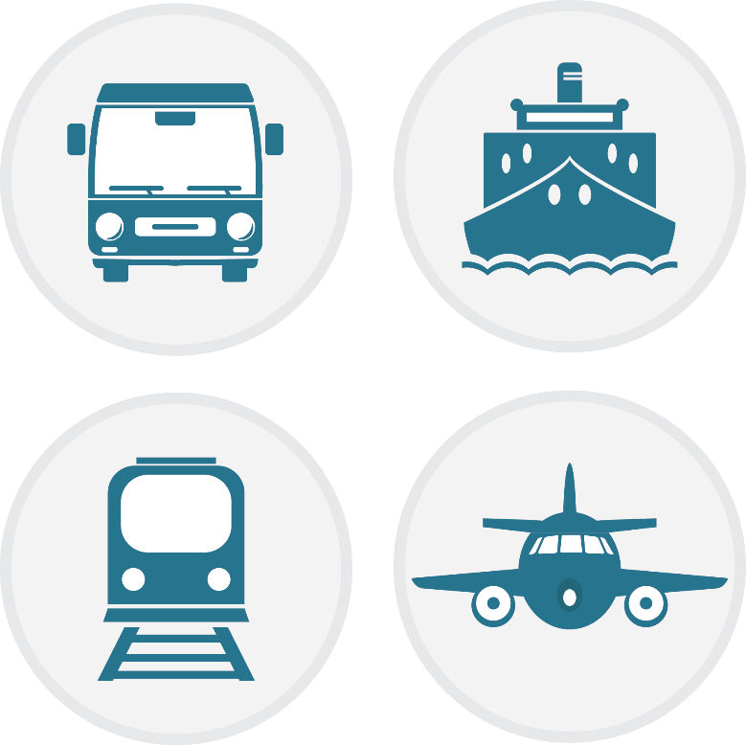
STATE GOVERNMENTS INCENTIVES:
State Ministries of Transportation:
Each state in Nigeria may have its own transportation department with specific funding programs for infrastructure projects. Contacting the relevant state ministries could reveal opportunities for financial assistance.
State Economic Development Agencies:
State economic development agencies may offer grants or incentives to projects that contribute significantly to local economic growth and job creation. Inquire about potential support for the regional rail project.
Public-Private Partnership Units (PPPU):
Some states have PPP units dedicated to facilitating private sector participation in infrastructure projects. Engage with these units to explore PPP models and potential incentives.

Slide 73

STATE GOVERNMENTS INCENTIVES:
State Budgetary Allocations:
Similar to the federal level, monitor state budgets for allocations to transportation and infrastructure. Advocacy for a share of the state budget for the regional rail project may be necessary.
State Investment Promotion Agencies:
Investment promotion agencies in each state could provide information on available incentives and opportunities for private investment in infrastructure projects.
Local Government Support:
Local governments in areas affected by the rail project may offer support in terms of land acquisition, permits, and community cooperation. Establishing positive relationships with local authorities is crucial.

Slide 74
EVALUATING EXISTING POLICIES AND REGULATIONS RELATING TO RAIL TRANSPORTATION.
National Transport Policy (NTP):
The NTP provides a broad framework for the development of transportation infrastructure in Nigeria, including rail transportation. It emphasizes the need for a well-integrated and efficient transportation system to support economic growth.
Railway Act of 1955:
The Railway Act of 1955 governs railway operations in Nigeria. It provides the legal framework for the establishment, operation, and maintenance of railways. This legislation may be due for an update to align with contemporary needs and challenges.
National Rail Transport Policy:
The National Rail Transport Policy outlines the government's strategic approach to the development of the rail sector. This policy may cover aspects such as network expansion, modernization, and the integration of rail transportation with other modes of transport.

Slide 75
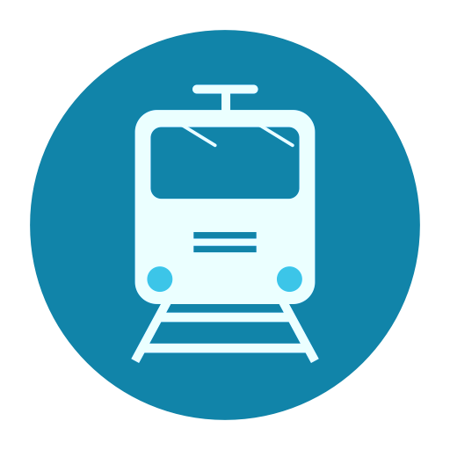
EVALUATION CONT’D
Infrastructure Concession Regulatory Commission (ICRC) Act:
The ICRC Act provides the legal basis for the concessioning of public infrastructure, including railways, to private sector entities. It outlines the procedures for engaging in Public-Private Partnerships (PPPs) in infrastructure development.
Transport Sector Reform (Roads and Rail) Bill:
On March 17, 2023, President Buhari signed the Fifth Alteration (No. 16), a measure which alters the constitution to move the item “railways” from the Exclusive Legislative List to the Concurrent Legislative List, thereby giving powers to both the Federal and State governments to regulate the subject.
National Economic Recovery and Growth Plan (ERGP):
The ERGP outlines the government's economic agenda, including strategies for infrastructure development. It may have provisions related to rail transport projects as part of the broader effort to boost the economy.

Slide 76
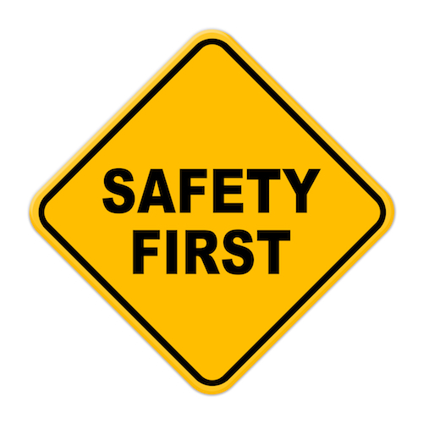
EVALUATION CONT’D
Regulatory Agencies:
The Nigerian Railway Corporation (NRC) is the primary agency responsible for rail transportation. The Nigerian Shippers' Council (NSC) also plays a role in regulating freight services. However, a more comprehensive regulatory framework may be needed to address current challenges and future developments.
Safety Regulations:
Safety in rail transportation is a critical aspect. There may be regulations governing safety standards, emergency response procedures, and the overall well-being of passengers and railway personnel.
Environmental Regulations:
Rail projects may need to comply with environmental regulations to ensure sustainable and eco-friendly practices. This includes measures to minimize the impact on ecosystems and communities along the rail routes.

Slide 77

EVALUATION CONT’D
Land Acquisition and Compensation:
Policies related to land acquisition, compensation for affected communities, and resettlement plans are crucial for large-scale rail projects. These policies need to balance infrastructure development with the protection of local communities. This is best handled by the State governments.
It's important to emphasize that the evaluation of policies and regulations should consider their effectiveness, relevance to current challenges, and alignment with industry best practices.

Slide 78

STAKEHOLDER ENGAGEMENT: Who are the Stakeholders?
Government Agencies:
Federal Ministry of Transportation (FMOT): The FMOT plays a central role in the development and regulation of transportation infrastructure, including railways, at the federal level.
Nigerian Railway Corporation (NRC):
The NRC is the government agency responsible for the operation of railways in Nigeria. Collaboration with NRC is essential for project alignment and regulatory compliance.
Infrastructure Concession Regulatory Commission (ICRC): For projects involving Public-Private Partnerships (PPPs) or concessions, engagement with ICRC is necessary for regulatory approvals.

Slide 79
STAKEHOLDERS CONT’D
State and Local Government Authorities:
State Ministries of Transportation: Relevant state ministries oversee transportation within their jurisdictions. Coordination with these ministries is essential for regional alignment and approvals.
Local Government Authorities: Local governments along the rail route will have a direct interest in the project. Engaging with local authorities ensures community representation and support.
Communities and Residents:
Community Leaders and Traditional Rulers: Building relationships with community leaders and traditional rulers helps in understanding local dynamics, addressing concerns, and securing community support.

Slide 80
STAKEHOLDERS CONT’D
Residents and Community Members: Direct engagement with residents along the rail route is crucial for addressing potential impacts, ensuring benefits, and minimizing disruptions during construction and operation.
Investors and Financiers:
Domestic and International Investors: Private investors interested in infrastructure projects, especially in transportation, are key stakeholders. Engaging with potential investors ensures financial support and may involve discussions on PPP models.
Development Finance Institutions (DFIs): Institutions like the African Development Bank (AfDB) or World Bank may provide financing or support for the rail project.
Regulatory Bodies:
Nigerian Railway Regulatory Commission (NRRC): The NRRC plays a regulatory role in the railway sector. Compliance with regulatory standards is essential for project approval and operation.

Slide 81

STAKEHOLDERS CONT’D
Environmental and Social Impact Assessment (ESIA) Consultants:
Environmental Agencies: Engaging with environmental agencies ensures compliance with environmental regulations. ESIA consultants can help assess and mitigate potential environmental and social impacts of the project.
Transport Users and Stakeholder Associations:
Transport Users Associations: Representing the interests of potential rail users, these associations can provide valuable input and feedback on the design and operation of the rail network.
Technical and Engineering Consultants:
Engineering Firms: Hiring engineering consultants is essential for project design, feasibility studies, and construction supervision. Their expertise ensures technical viability.

Slide 82

STAKEHOLDERS CONT’D
legal and compliance experts:
Legal Advisors: Legal experts help navigate regulatory frameworks, contractual agreements, and compliance issues, ensuring that the project adheres to local laws.
media and public relations:
Media Outlets and PR Agencies: Communicating the project's objectives, benefits, and progress to the public is crucial. Media and PR agencies assist in managing public perceptions and addressing concerns.
non-governmental organizations (ngos):
Community-Based NGOs: NGOs working at the community level can provide insights into local dynamics, advocate for community interests, and act as intermediaries between the project team and residents.

Slide 83
3. INVESTOR IDENTIFICATION AND ENGAGEMENT:
a. Investor Outreach:
i. We have developed this comprehensive investment proposal highlighting the project's benefits, returns, and risk mitigation strategies that may assist us
Engage with institutional investors, private equity firms, and infrastructure investment funds.
b. Public-Private Partnerships (PPP):
i. The opportunities for PPP arrangements, shared risks and rewards exist
ii. There is, therefore, a need to develop a framework for collaboration and revenue-sharing between the public and private sectors.

Slide 84

INVESTOR IDENTIFICATION CONT’D
c. Financing Options:
i. An equity investor has been secured for investment up to $15bn
ii. Other financing, such as loans, bonds, and equity investments, may need to be explored for peripheral infrastructure development.
ii. Working with local financial institutions to secure funding and assess the financial viability of the project may be necessary.

Slide 85

IS THIS A BUSINESS OPPORTUNITY?
Here are some crucial elements to consider whether the project is a viable business opportunity:
Crucial elements confirming South East and South Regional Project as a viable business opportunity.
Market Demand:
Current transportation infrastructure and gaps in connectivity within and between the South East and South South states.
( This is already looked at above)

Slide 86

ASSESSMENT OF TRANSPORTATION INFRASTRUCTURE IN NIGERIA:
Road Infrastructure:
Nigeria has an extensive road network; however, the quality varies significantly. Major highways connect major cities, but maintenance and expansion challenges exist
Traffic congestion, insufficient maintenance, and inadequate signage are common issues on many roads.
Rail Infrastructure:
The rail network in Nigeria is limited compared to the road network. The existing lines primarily connect major cities in the northern and southern parts of the country.
The South East and South regions have relatively limited rail connectivity, and there is potential for expansion to enhance regional and national integration.

Slide 87

Air Transportation:
Nigeria has a network of airports serving domestic and international flights.
Air connectivity within and between the South East and South South regions is facilitated by airports such as the Akanu, ibiam International Airport in Enugu and the Port Harcourt International Airport. However, additional airport development and alternative safe transportation such as rail may be needed to accommodate growing demand.
Water Transportation:
Nigeria has an extensive network of rivers and coastal areas, making water transportation a viable option.
Inland waterways, such as the Niger River, provide opportunities for transportation, but challenges include navigability and infrastructure development.

Slide 88
Gaps in Connectivity within and Between South East and South South States:
Limited Rail Connectivity:
Rail connectivity within and between the South East and South South regions is limited. Expanding and modernizing rail infrastructure could significantly improve connectivity and logistics.
Road Network Quality:
While roads connect major cities in the regions, the quality and capacity of some roads need improvement. Potholes, inadequate maintenance, and insufficient dualization of major highways can impede smooth transportation.

Slide 89

GAPS IN CONNECTIVITY CONT’D
Air Connectivity:
Although there are airports in key cities, enhancing air connectivity within the regions and ensuring the functionality of existing airports could improve transportation options but travel cost sometimes not affordable by many.
Water Transportation Challenges:
Inland water transportation faces challenges such as the need for dredging, maintaining navigability, and optimizing water transport routes.
Integration of Modes:
There is room for improved integration of various transportation modes (road, rail, air, and water) to create a seamless and efficient transportation network.

Slide 90

GAPS IN CONNECTIVITY CONT’D
Urban Transportation Planning:
Urban centers within the South East and South South regions may experience traffic congestion and insufficient public transportation infrastructure. Urban planning initiatives can address these challenges.
Last-Mile Connectivity:
Enhancing last-mile connectivity from transportation hubs to rural and underserved areas is essential to ensure comprehensive coverage.
Infrastructure Maintenance:
Adequate maintenance of existing infrastructure is crucial to prevent deterioration and ensure the longevity of transportation assets.

Slide 91

Analyzing the growing population, economic activities, and urbanization trends in the South East and South South regions of Nigeria provides valuable insights into the potential demand for improved transportation infrastructure, including a regional rail network.
Here's an analysis of these key factors:

Slide 92

KEY FACTORS ANALYSIS CONT’D
Population Growth:
Population growth in South East and South South regions drives increased mobility demands for work, education, and other purposes, fueled by urbanization and city migration, highlighting the need for efficient transportation systems.
Urbanization Trends:
Rising urbanization in South East and South South regions spurs city growth and traffic congestion, emphasizing the necessity for sustainable and efficient public transportation. Integrated transportation systems are vital to meet the mobility needs of the expanding urban population.

Slide 93

ECONOMIC ACTIVITIES:
KEY FACTORS ANALYSIS CONT’D
The South East and South South regions are economically vibrant, with diverse economic activities contributing to Nigeria's GDP. In 2023, Nigeria's GDP amounted to $407.15 billion, and the SESS states contributed over 33% of this GDP. This means that over 33% of goods and services produced and sold by Nigeria in 2023 were produced in the SESS region with Rivers, Akwo Ibom, Imo, Delta and Anambra outperforming other States in Nigeria
Prominent economic activities include; manufacturing, agriculture, and oil and gas production are These sectors require efficient transportation networks for the movement of goods, raw materials, and personnel.
Improved transportation infrastructure, including a regional rail network, would facilitate the smooth flow of goods and services, reducing logistics costs and enhancing economic productivity.

Slide 94

KEY FACTORS ANALYSIS CONT’D
Trade and Commerce:
The regions are hubs for trade and commerce, and efficient transportation is crucial for the movement of goods within and outside the regions. A regional rail network would provide a reliable and cost-effective means of transporting goods, supporting trade activities.
Industrialization:
The presence of industries in sectors such as manufacturing, petrochemicals, and agribusiness contributes to the economic development of the regions. These industries often require robust transportation infrastructure for the distribution of products and raw materials.

Slide 95

KEY FACTORS ANALYSIS CONT’D
Education and Healthcare:
Educational and healthcare institutions are concentrated in urban areas, attracting people from various parts of the regions. Improved transportation links, including rail connectivity, would facilitate the movement of students, healthcare professionals, and patients.
Tourism Potential:
The South East and South South regions are endowed with cultural and natural attractions that have the potential to attract tourists. Enhanced transportation infrastructure, including rail, can make these destinations more accessible, fostering tourism and economic growth.

Slide 96
KEY FACTORS ANALYSIS CONT’D
Government Initiatives:
Government initiatives for regional development and economic diversification underscore the need for enhanced transportation, aligning with projects like a regional rail network
A regional rail network could catalyze economic growth, boost connectivity, and meet evolving transportation needs, fostering increased trade, job creation, and economic development across industries like agriculture, manufacturing, and services.

Slide 97
THANK YOU

